Slide 1
Deep Learning with Differential Privacy
The 23rd ACM Conference on Computer and Communications Security (CCS 2016)
张文博 2022.01.21

Slide 2
Abstract
Deep learning has achieved remarkable results in many fields.
The dataset used to train the model may contain sensitive information.
We develop new algorithmic techniques for learning.
We develop refined analysis of privacy costs within the framework of differential privacy.

Slide 3
Introduction
moments accountant
We demonstrate by tracking detailed information (higher moments) of the privacy loss, we can obtain much tighter estimates on the overall privacy loss.
We improve the computational efficiency of differentially private training by introducing new techniques.
We build on the machine learning framework TensorFlow for training models with differential privacy. We evaluate our approach on two standard image classification tasks, MNIST and CIFAR-10.

Slide 4
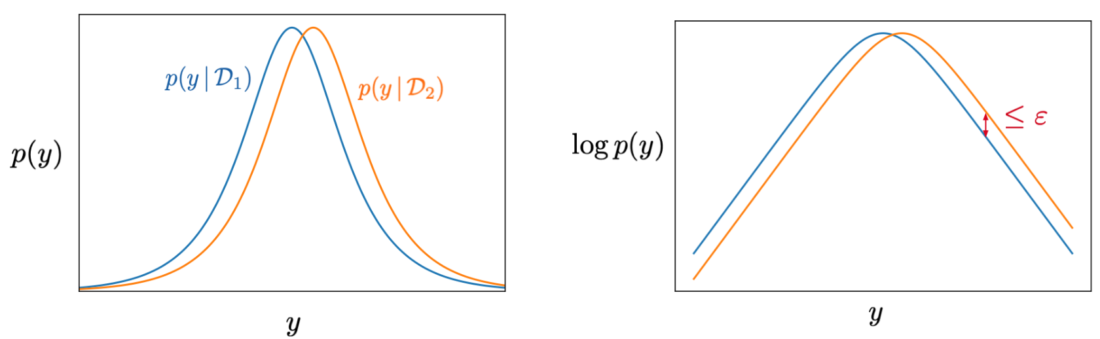
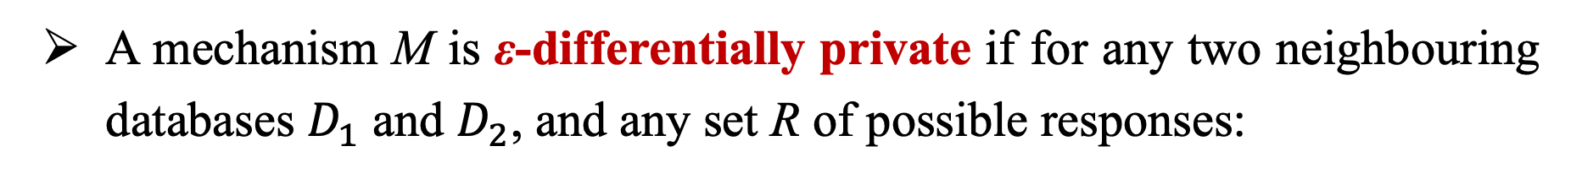
Background：Differential Privacy
A mechanism M is ε-differentially private if for any two neighbouring databases $D_{1}$ and $D_{2}$, and any set R of possible responses:

Slide 5
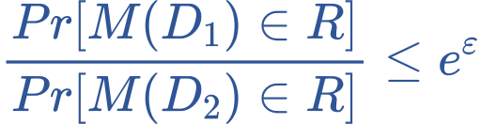
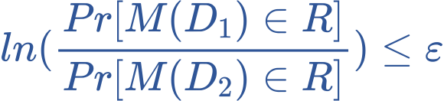
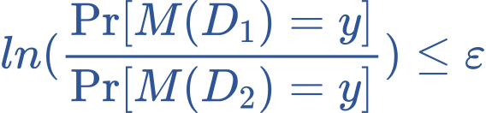
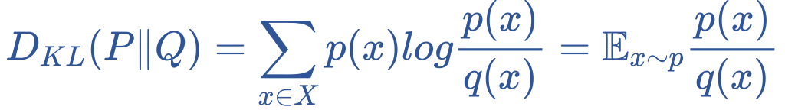
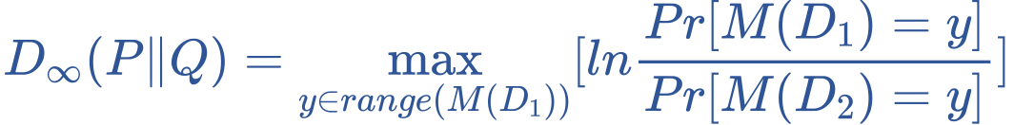
Background：Differential Privacy
⇒
⇒
⇒
⇒
privacy budget
KL-Divergence: It measures how different two probability distributions are.
Max-Divergence:

Slide 6
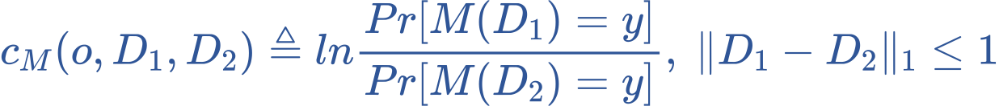
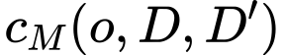
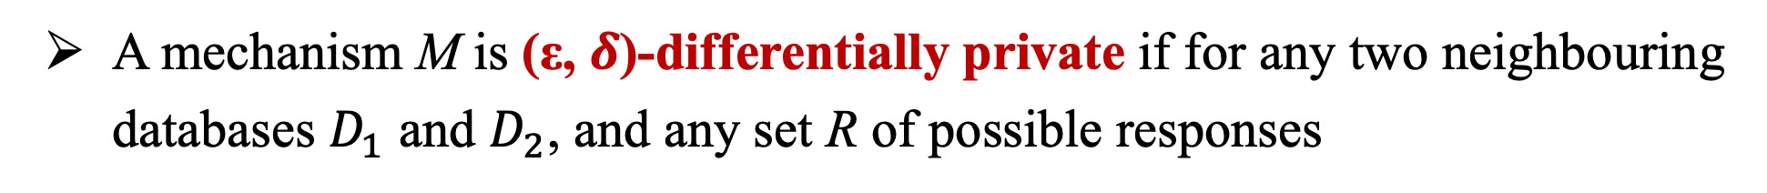
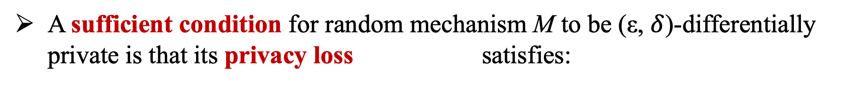
Background：Differential Privacy
Privacy loss: For a random mechanism M, output o and two datasets D₁ and D₂, privacy loss C_{M} is defined as:
A mechanism M is (ε, $δ$)-differentially private if for any two neighbouring databases $D_{1}$ and $D_{2}$, and any set R of possible responses
A sufficient condition for random mechanism M to be (ε, $δ$)-differentially private is that its privacy loss c_{M}(o,D,D’) satisfies:

Slide 7
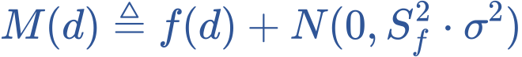
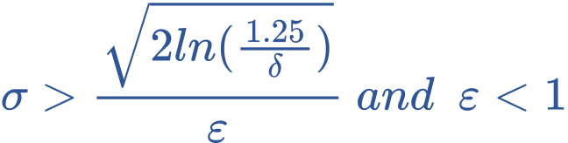
Background：Differential Privacy
A common paradigm for approximating a deterministic real-valued function f :D → R with a differentially private mechanism is via additive noise calibrated to f ′s sensitivity S_{f} : the maximum of the absolute distance |f (d) − f (d′ )| where d and d′ are adjacent inputs.
The Gaussian noise mechanism is defined by:
where N (0, S_{f} ² · σ²) is the normal (Gaussian) distribution with mean 0 and standard deviation S_{f} σ .
M satisfies (ε, $δ$)-differentially private if:

Slide 8
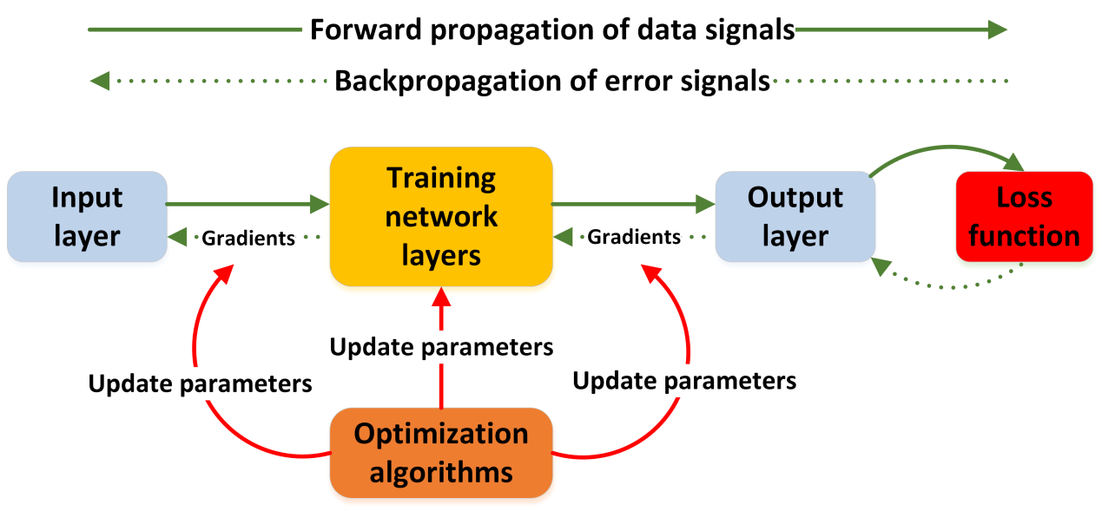
Background：Deep Learning

Slide 9
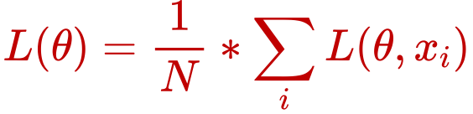
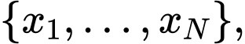
Background：Deep Learning
We define a loss function L that represents the penalty for mismatching the training data.
The loss L(θ) on parameters θ is the average of the loss over the training examples .
Training consists in finding θ that yields an acceptably small loss, hopefully the smallest loss.

Slide 10
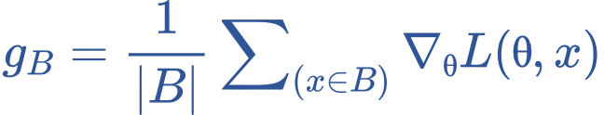
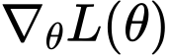
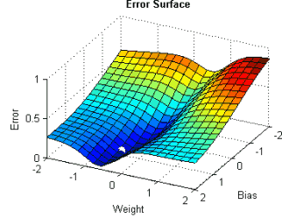
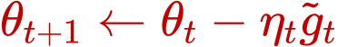
Background：Deep Learning
In practice, the minimization is often done by the mini-batch stochastic gradient descent (SGD) algorithm.
In this algorithm, at each step, one forms a batch B of random examples and computes as an estimation to the gradient .
Then θ is updated following the gradient direction −g_{B} towards a local minimum.

Slide 11
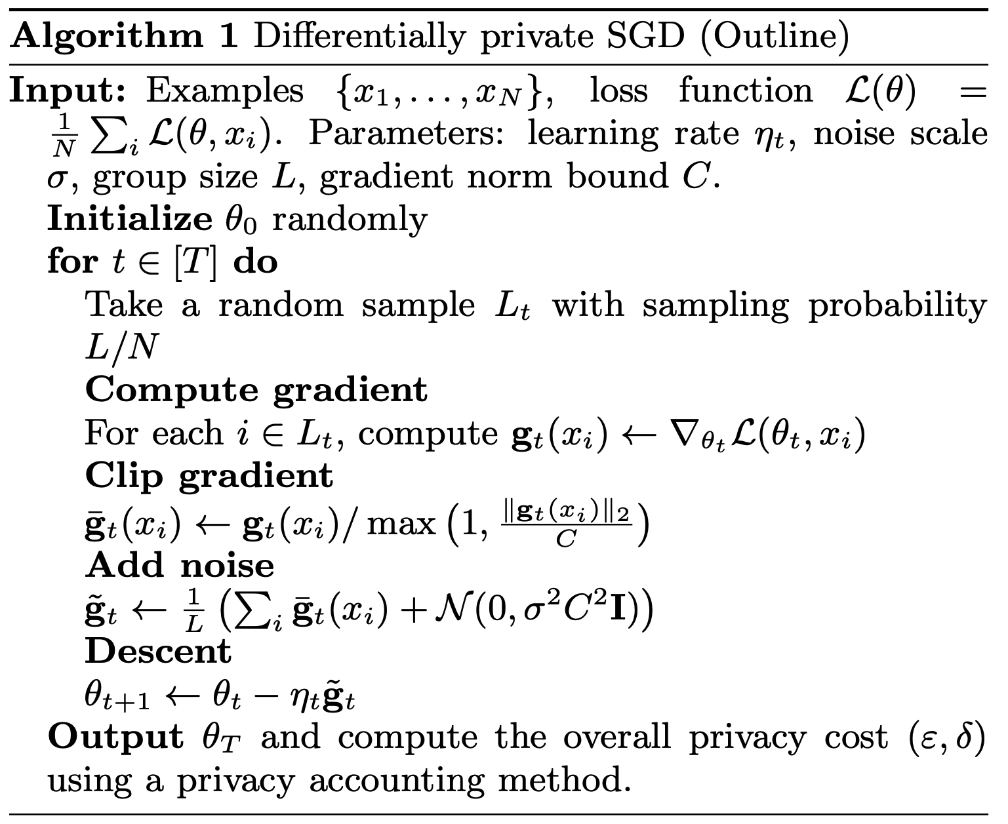
Our Approch—Differentially Private SGD Algorithm
Norm clipping:
If ∥g∥₂ ≤ C, g is preserved, or C is preserved.
Per-layer and time-dependent parameters :
For multi-layer neural networks, we consider each layer separately, which allows setting different clipping thresholds C and noise scales
σ for different layers.
Lots:
We perform the computation in batches, then group several batches into a lot for adding noise. Batch size is much smaller than lot size.

Slide 12
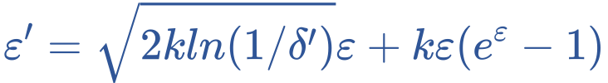
Our Approch—Moments Accountant
(Supplement: Composition Theory in Differential Privacy)
Basic Composition: Does not consider dependencies between query functions.
Let M_{i} each provide 𝜀-differential privacy. The sequence of M_{i}(X) provides (∑_{i} 𝜀_{i})-differential privacy.
Advanced Composition: Consider dependencies between query functions.
Navie Composition Throrem
The class of 𝜀-differentially private mechanisms satisfies k𝜀-differential privacy under k-fold adaptive composition.
Strong Composition Throrem
Let 𝜀,𝛿 ≥ 0. The class of (𝜀,𝛿)-differential private mechanisms satisfies (𝜀′, k𝛿+𝛿′)-differential privacy under k-fold adaptive composition for:

Slide 13
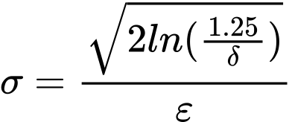

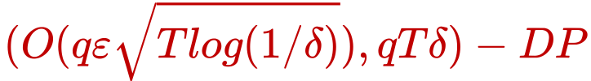

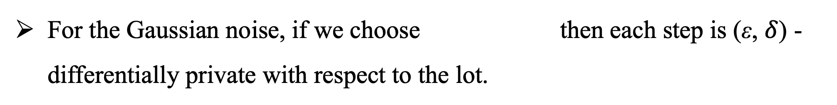
Our Approch—Moments Accountant
For the Gaussian noise, if we choose then each step is (ε, $δ$) -differentially private with respect to the lot.
With respect to the full database where q = L / N, each step is (O(qε), qδ) - differentially private.
Throrem | After T iterations, the constraint | Features considered
Navie Composition Throrem |  | Range of Privacy Loss
Strong Composition Throrem |  | Range of Privacy Loss and E(Privacy Loss )
Moments Accountant |  | Moment Generating Function of Privacy Loss

Slide 14
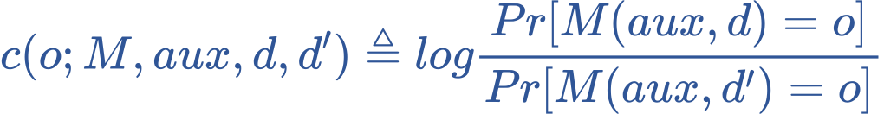
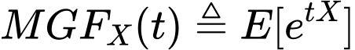
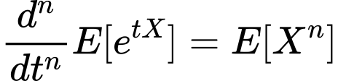
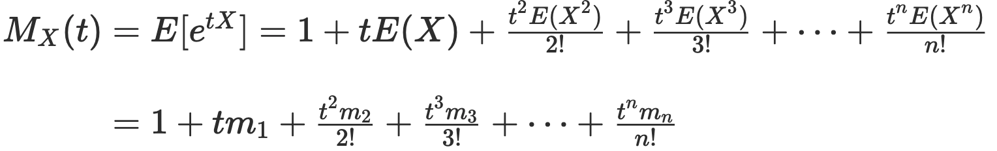
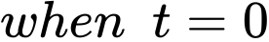
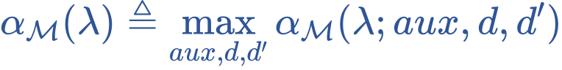
Our Approch—Moments Accountant
More specifically, for neighboring databases d, d′ ∈ D_{n}, a mechanism M, auxiliary input aux, and an outcome o ∈ R, define the privacy loss at o as :
For a given mechanism M, we define the λth moment α_{M}(λ;aux,d,d′) as the log of the moment generating function evaluated at the value λ:
For a random variable X, ( )
In order to prove privacy guarantees, it is useful to bound all possible α_{M}(λ;aux,d,d’). We define:

Slide 15
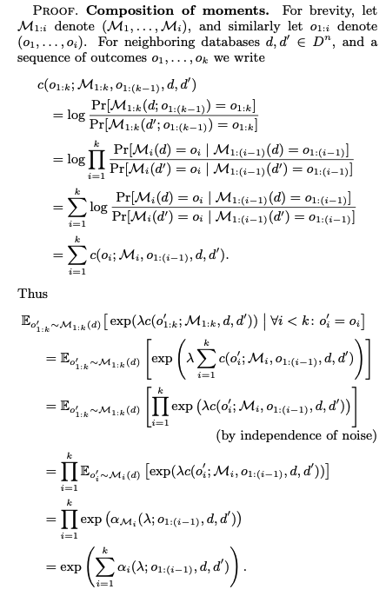
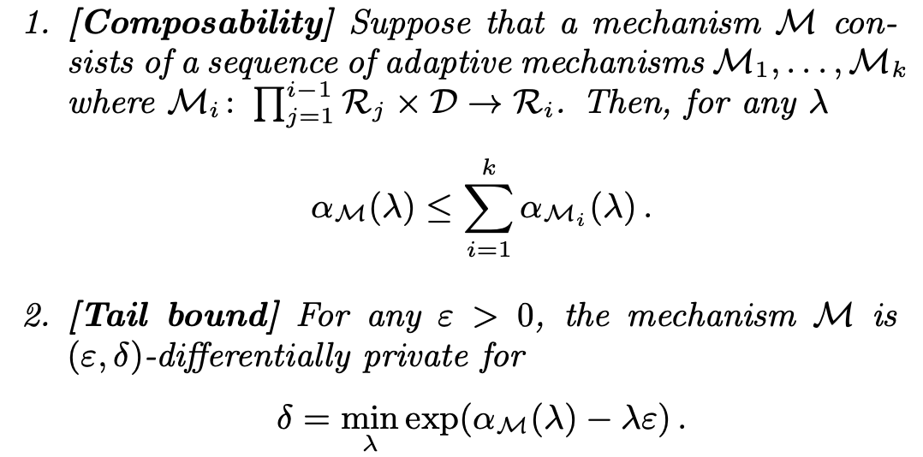
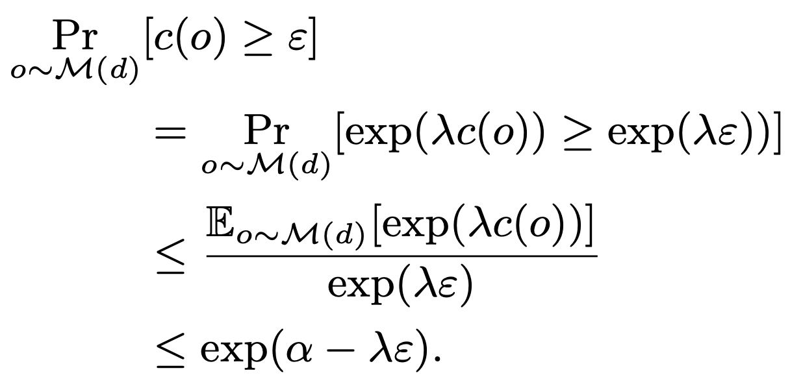
Our Approch—Moments Accountant
It suffices to compute, or bound, α_{Mi} (λ) at each step and sum them to bound the moments of M.

Slide 16
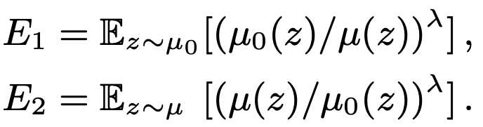
Our Approch—Moments Accountant
The main challenge that remains is to bound the value α_{Mt} (λ) for each step.
Let μ₀ denote the probability density function (pdf) of N(0, σ² ), and μ₁ denote the pdf of N(1, σ² ).
Let μ be the mixture of two Gaussians μ = (1 − q)μ₀ + qμ₁. Then we need to compute α(λ) = log max(E1 , E2 ) where

Slide 17
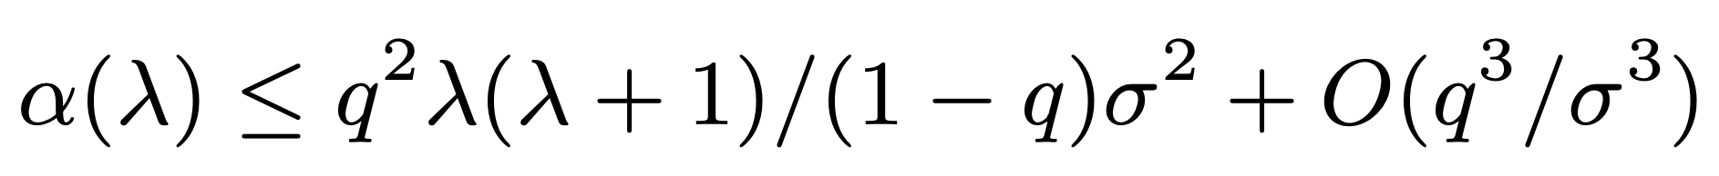
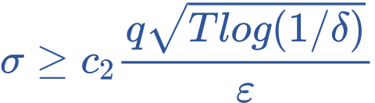
Our Approch—Moments Accountant
The asymptotic bound of ɑ(λ):
There exist constants c₁ and c₂ so that given the sampling probability q = L/N and the number of steps T, for any ε < c₁q²T, Algorithm 1 is (ε,δ)-differentially private for any δ > 0 if we choose

Slide 18
Our Approch—Hyperparameter Tuning
Through experiments, we observe that model accuracy is more sensitive to training parameters such as batch size and noise level than to the structure of a neural network.
A reasonable tradeoff is to take the number of batches per epoch to be of the same order as the desired number of epochs.
We do find that there is a small benefit to starting with a relatively large learning rate, then linearly decaying it to a smaller value in a few epochs, and keeping it constant afterwards.

Slide 19
Implementation—Principal component analysis (PCA)
Main idea：
The goal of reducing a set of N-dimensional vectors to K-dimension is to select K unit orthonormal bases, so that after the original data is transformed to this set of bases, the covariance between each variable is 0, and the variance of the variables is as large as possible. (Under the constraint of orthogonality, take the largest K variances).
将一组 N 维向量降为 K 维，其目标是选择 K 个单位正交基，使得原始数据变换到这组基上后，各变量两两间协方差为 0，而变量方差则尽可能大（在正交的约束下，取最大的 K 个方差）。

Slide 20
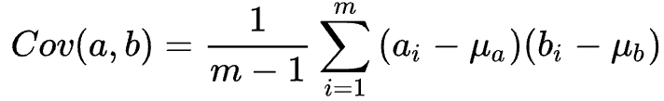
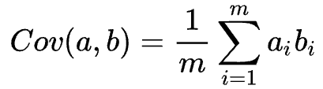
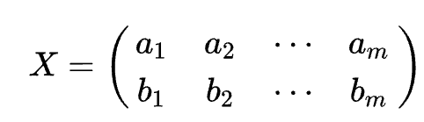
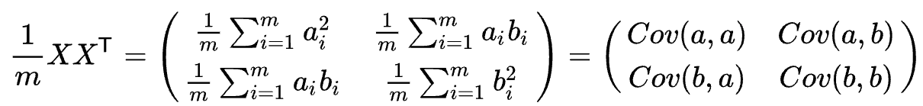

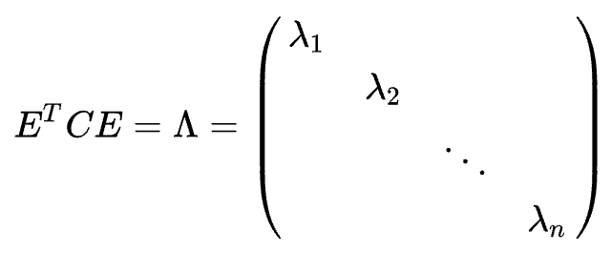
Implementation—Principal component analysis (PCA)
For m-dimensional data a and b, m is large:
μ_{a}=μ_{b}, m is large
⇒
P is a matrix composed of a group of basis vectors by rows, set Y = PX, then Y is the data after the basis transformation of X to P.
A n×n real symmetric matrix must find n unit orthogonal eigenvectors. Let these n eigenvectors be e₁,e₂,...,e_{n}(column vector), matrix E= (e₁,e₂,...,e_{n}).
Take the first k rows of E to form a matrix P
Y = PX, Y is the new data.
reduce

Slide 21
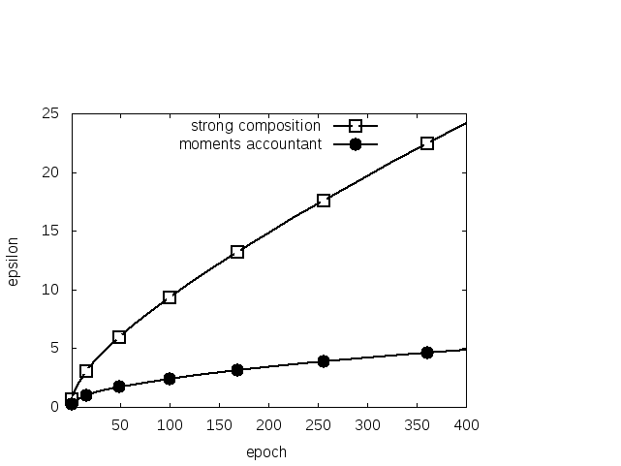
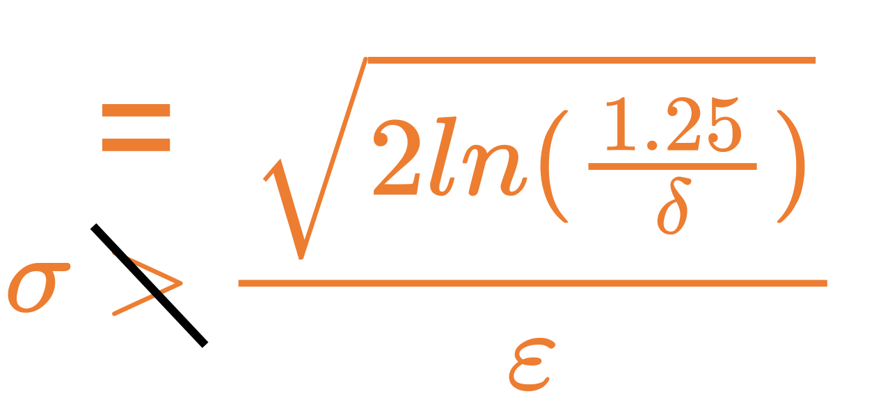
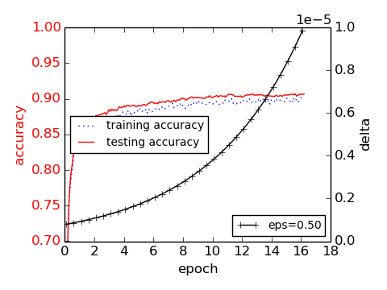
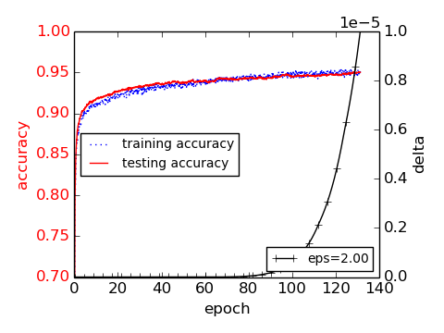
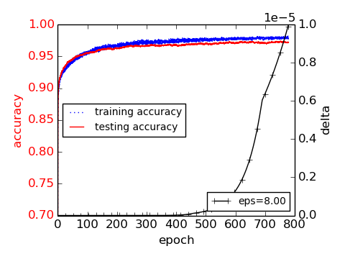
Experimental Results (MINIST)
Set q = 0.01, σ = 4, and δ = 10⁻⁵
Baseline model: A 60-dimensional PCA projection layer and a single hidden layer with 1,000 hidden units. Using the lot size of 600.We can reach accuracy of 98.30% in about 100 epochs.
Differentially private model: 1,000-unit ReLU hidden layer, clip the gradient norm of each layer at 4, add noise.

Slide 22
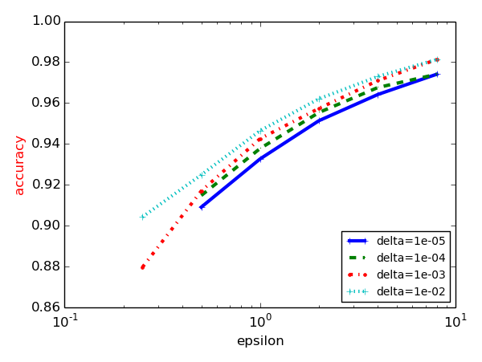
Experimental Results (MINIST)
By using the moments accountant, we can obtain a δ value for any given ε. In the figure, each curve corresponds to the best accuracy achieved for a fixed δ.
As can be observed from the figure, for a fixed δ, varying the value of ε can have large impact on accuracy, but for any fixed ε, there is less difference with different δ values.

Slide 23
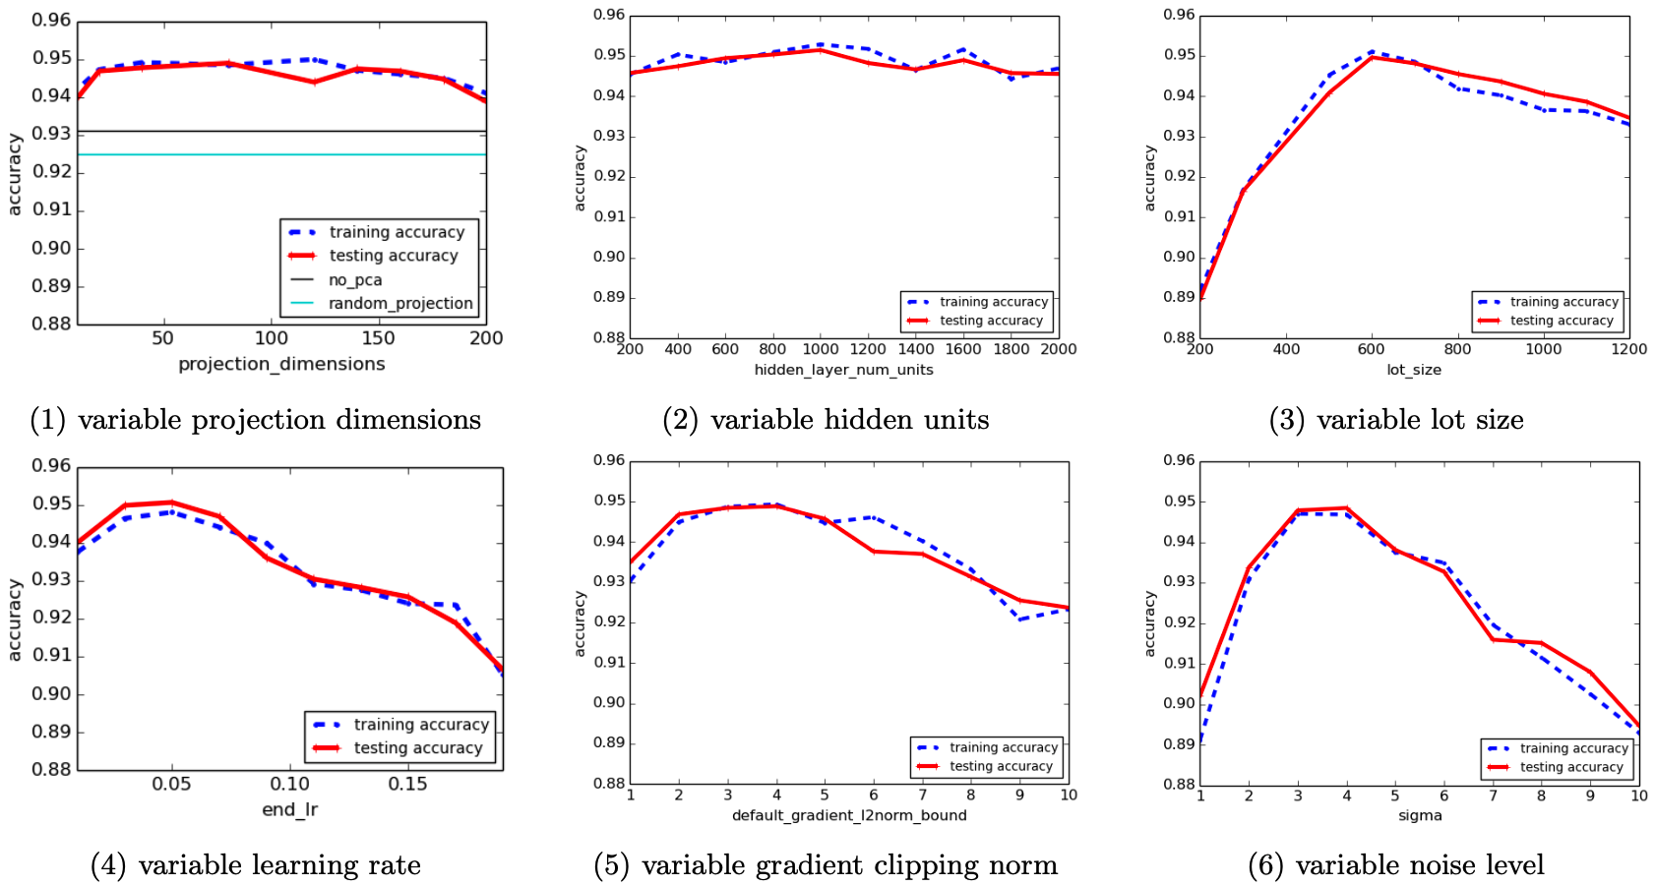
Experimental Results (MINIST)

Slide 24
Thank You For Listening！
张文博 2022.01.21

